Slide 1
Unit – III (Problem Solving by Searching)
Dipesh Koirala

Slide 2
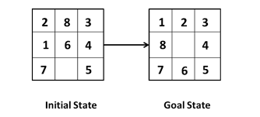
Scenario
Problem solving is a systematic process to solve a problem or to reach some predefined goal or solution.
State space is the set of all states reachable
from initial state in the space or environment.
What we do is we search the way to solution in our state space.

Slide 3
Searching and Problem Solving
Searching is a commonly used method in AI for solving problems.
The search technique explores the possible moves that one can make in a space of ‘states’ called the search space.
Problem Solving:
Problem solving is a systematic search through a range of possible actions in order to reach some predefined goal or solution.
For problem solving a kind of goal based agent called problem solving agents are used.
This agent first formulates a goal and a problem, searches for a sequence of actions that would solve the problem, and then executes the actions one at a time.
When this is complete, it formulates another goal and starts over.

Slide 4
Searching and Problem Solving
Four general steps in problem solving:
Goal formulation – What are the successful world states
Problem formulation – What actions and states to consider given the goal
Search – Determine the possible sequence of actions that lead to the states of known values and then choosing the best sequence.
Execute – Give the solution perform the actions

Slide 5
Problem Formulation
Problem formulation is the process of deciding what actions and states to consider, given a goal.
Therefore, the agent’s task is to find out how to act, now and in the future, so that it reaches a goal state.
Before it can do this, it needs to decide(or we need to decide on its behalf) what sorts of actions and states it should consider.
A problem is defined by:
An initial state: State from which agent start
Successor function: Description of possible actions available to the agent.
Goal test: Determine whether the given state is goal state or not
Path cost: Sum of cost of each path from initial state to the given state.
A solution is a sequence of actions from initial to goal state. Optimal solution has the lowest path cost.
One way to formally define a problem: State Space Representation

Slide 6
State Space Representation
The set of all states reachable from the initial state by any sequence of actions is called state space.
The state space forms a directed graph in which nodes are states and the links between nodes are actions.
A State space representation allows for the formal definition of a problem which makes the movement from initial state to goal state quite easy.
A solution is a path from the initial state to a goal state
State space representation of Vacuum World Problem.
Initial state: Any state can be designated as the initial state.
Successor Function: In this simple environment, each state has just three actions: Left, Right, and Suck
Goal Test: This checks whether all the squares are clean.
Path cost: Each step costs 1, so the path cost is the number of steps in the path.

Slide 7
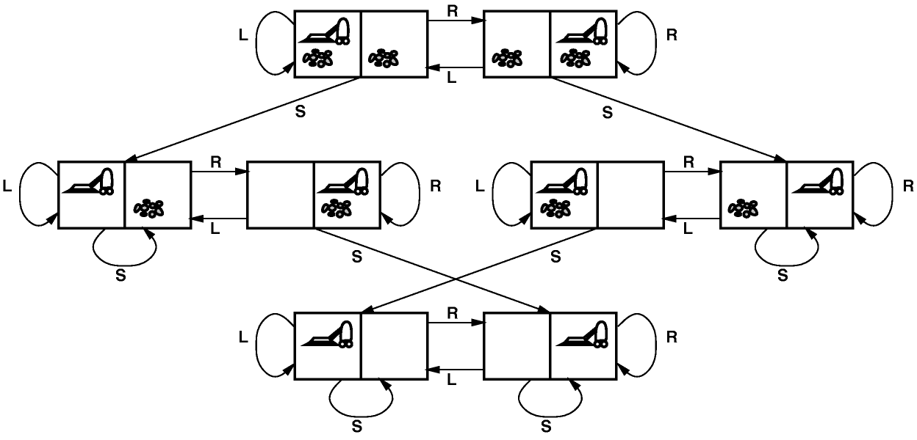
State Space Representation
State space representation of Vacuum World Problem.
Initial state: Any state can be designated as the initial state.
Successor Function: In this simple environment, each state has just three actions: Left, Right, and Suck
Goal Test: This checks whether all the squares are clean.
Path cost: Each step costs 1, so the path cost is the number of steps in the path.

Slide 8
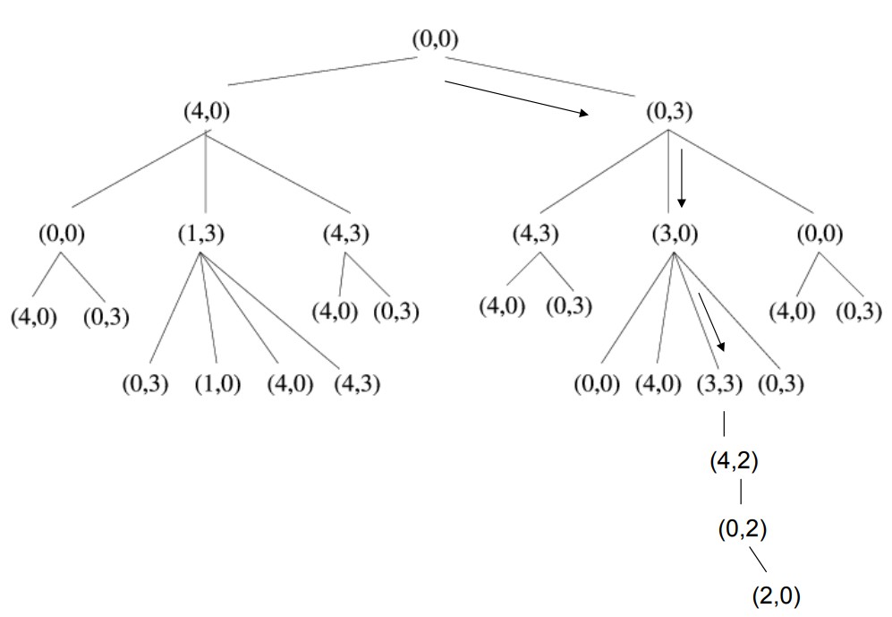
State Space Representation
The water jug problem:
Suppose you are given 2 jugs ( 1 of 3 liters and 1 of 4 liters). Goal : get exactly 2L in the 4L jug)
Solution Paradigm:
-build a simple production system for solving this problem.
-represent the problem by using the state space paradigm.

Slide 9
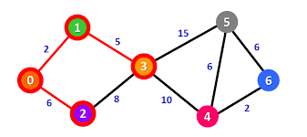
Route Finding Problem
Find route from 0 to 6
Problem Formulation may be as follows:
Initial State: 0
Successor Function: move from one state to another
Goal test: whether the arrived state is goal or not
Path cost: total distance, money or time

Slide 10
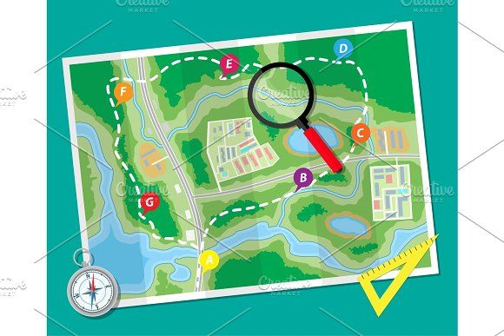
Searching for Solution
Having formulated some problems, we now need to solve them.
To solve a problem we should perform a systematic search through a range of possible actions in order to reach some predefined goal or solution.
A solution is an action sequence, so search algorithms works by considering various possible action sequences.
The possible action sequences starting at the initial state form a search tree with the initial state at the root; the branches are actions and the nodes correspond to states in the state space of the problem
Consider a problem represented with a state space graph. The nodes represent states and the links represent action from one state to another. The number associated to a link represents the cost of links.

Slide 11
Measuring problem solving performance
We will evaluate the performance of a search algorithm in four ways:
Completeness: An algorithm is said to be complete if it definitely finds solution to the problem, if exist.
Time Complexity: How long (worst or average case) does it take to find a solution? Usually measured in terms of the number of nodes expanded
Space Complexity: How much space is used by the algorithm? Usually measured in terms of the maximum number of nodes in memory at a time
Optimality/Admissibility: If a solution is found, is it guaranteed to be an optimal one? For example, is it the one with minimum cost?
Time and space complexity are measured in terms of
b -- maximum branching factor (number of successor of any node) of the search tree
d -- depth of the least-cost solution
m -- maximum length of any path in the space

Slide 12
Search Methods
There are two broad classed of search methods:
uninformed (or blind) search methods
heuristically informed search methods.
Uninformed Search Methods: Strategies have no additional information about states beyond that provided in the problem definition.
All they can do is generate successors and distinguish a goal state from a non-goal state.
Uses no domain-specific information to judge where the solution is likely to lie. No judgement or additional knowledge is used.
It proceeds systematically by exploring nodes either randomly or in some predetermined order.
Types:
Breadth First search (BFS)
• Variation: Uniform cost search
Depth First search (DFS)
• Variations: Depth limit search, Iterative deepening DFS, Bidirectional search

Slide 13
Search Methods
Informed search methods: Domain-dependent(heuristic) information is used in order to search the space more efficiently.
Greedy best-first search
A* search

Slide 14
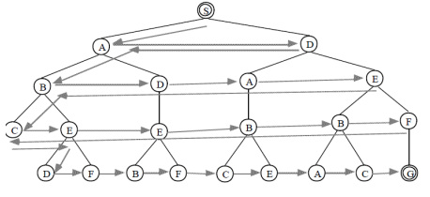
Breadth First Search
Breadth First search is a simple strategy in which the root node is expanded first, then all the successors of the root node are expanded next, then their successors, and so on.
In general, All nodes are expended at a given level in the search tree before any nodes at the next level are expanded until the goal reached.
i.e., Expand shallowest unexpanded node. (Queue is used)

Slide 15
BFS Evaluation
Completeness: Does it always find a solution if one exists?
YES
If shallowest goal node is at some finite depth d and If b is finite
Time complexity:
Assume a state space where every state has b successors, root has b successors, each node at the next level has again b successors (total b ² ), …
Assume solution is at depth d
Worst case; expand all except the last node at depth d
Total no. of nodes generated: b + b² + b³ + ………………….. b^{d} + ( b^{d+1} –b) = O(b^{d+1})
Space complexity: Each node that is generated must remain in memory
Total no. of nodes in memory: 1+ b + b² + b³ + ………………….. b^{d} + ( b^{d+1} –b) = O(b^{d+1})
Optimal (i.e., admissible): if all paths have the same cost.
Otherwise, not optimal but finds solution with shortest path length (shallowest solution).
If each path does not have same path cost shallowest solution may not be optimal

Slide 16
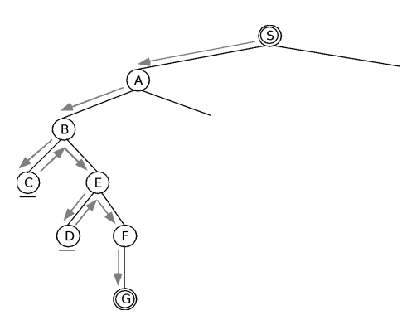
Depth First Search
DFS also begins by expanding the initial node.
Looks for the goal node among all the children of the current node before using the sibling of this node
i.e. expand deepest unexpanded node(expand most recently generated deepest node first.).

Slide 17
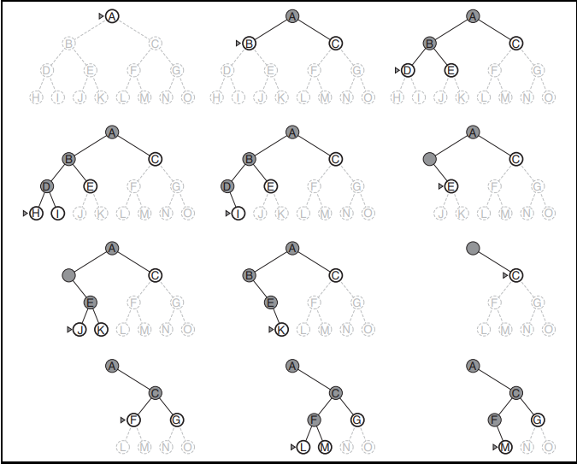
Depth First Search
DFS

Slide 18
DFS Evaluation
Completeness
Does it always find a solution if one exists?
NO, If search space is infinite and search space contains loops then DFS may not find solution.
Time complexity
Let, m is the maximum depth of the search tree. In the worst case Solution may exist at depth m, root has b successors, each node at the next level has again b successors (total b ² ), …
Worst case; expand all except the last node at depth m
Total no. of nodes generated: b + b² + b³ + ………………….. b^{m} = O(b^{m})
Space Complexity:
It needs to store only a single path from the root node to a leaf node, along with remaining unexpanded sibling nodes for each node on the path.
Total no. of nodes in memory: 1+ b + b + b + ………………….. b m times = O(bm)
Optimal (i.e admissible)
DFS expand deepest node first, if expands entire let sub-tree even if right sub-tree contains goal nodes at levels 2 or 3.
Thus we can say DFS may not always give optimal solution.

Slide 19
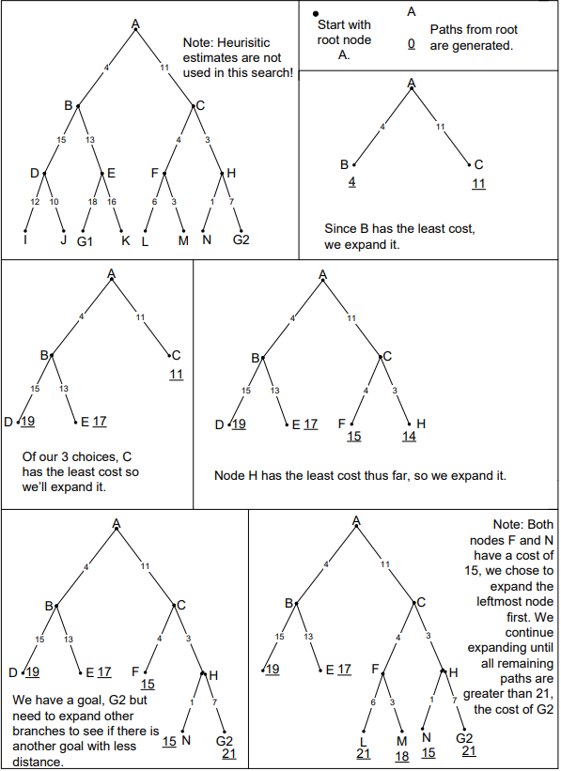
Uniform Cost Search
modified version of BFS to make optimal.
tree search algorithm used for traversing or searching a weighted tree, tree structure, or graph. The search begins at the root node.
The search continues by visiting the next node which has the least total cost from the root. Nodes are visited in this manner until a goal state is reached.
search algorithm involves expanding nodes by adding all unexpanded neighboring nodes that are connected by directed paths to a priority queue.
In the queue, each node is associated with its total path cost from the root, where the least-cost paths are given highest priority.
The uniform-cost search is complete and optimal if the cost of each step exceeds some positive bound ε.

Slide 20
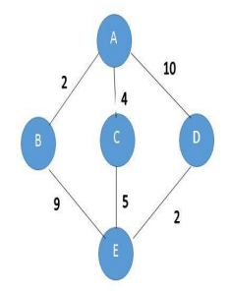
Uniform Cost Search
Find path from A to E
Expand A to B,C,D
The path to B is the cheapest one with path cost 2.
Expand B to E , Total path cost = 2+9 =11
This might not be the optimal solution since the path AC as path cost 4 ( less than 11)
Expand C to E, Total path cost = 4+5 =9
Path cost from A to D is 10 ( greater than path cost, 9) Hence optimal path is ACE

Slide 21
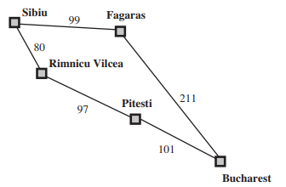
Uniform Cost Search
Find path from Sibiu to Bucharest

Slide 22
Uniform Cost Search Evaluation
Uniform-cost search is guided by path costs rather than depths, so its complexity is not easily characterized in terms of b and d.
Instead, let C∗ be the cost of the optimal solution and assume that every action costs at least ε.
Then the algorithm’s worst-case time and space complexity is O(b^{1+լC*/ ε˩}), which can be much greater than b^{d}.
This is because uniform cost search can explore large trees of small steps before exploring paths involving large and perhaps useful steps.
When all step costs are equal, b^{1+լC*/ ε˩} is just b^{d+1}
When all step costs are the same, uniform-cost search is similar to breadth-first search, except that the bfs stops as soon as it generates a goal, whereas uniform-cost search examines all the nodes at the goal’s depth to see if one has a lower cost
Thus uniform-cost search does strictly more work by expanding nodes at depth d unnecessarily.

Slide 23
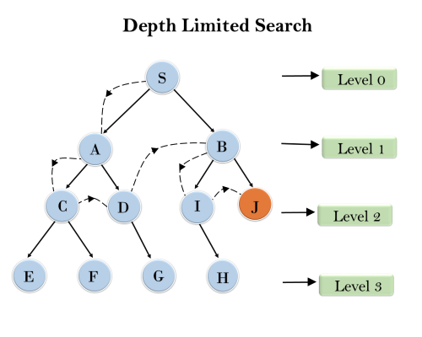
Depth Limited Search
Variations of DFS
It works exactly like depth-first search, but avoids its drawbacks regarding completeness by imposing a maximum limit on the depth of the search.
It will not follow infinitely deep paths or get stuck in cycles.
This will find a solution if it is within the depth limit, which guarantees at least completeness on all graphs.
It solves the infinite-path problem of DFS. Yet it introduces another source of problem if we are unable to find good guess of l. Let d is the depth of shallowest solution.
Completeness: If l < d then incompleteness results.
Optimal: If l > d then not optimal.
Time complexity: O( b^{l} )
Space complexity: O ( bl )

Slide 24
Iterative Deepening Depth-First Search
In this strategy, depth-limited search is run repeatedly, increasing the depth limit with each iteration until it reaches d, the depth of the shallowest goal state.
It does this by gradually increasing the limit—first 0, then 1, then 2, and so on—until a goal is found
On each iteration, IDDFS visits the nodes in the search tree in the same order as depth first search, but the cumulative order in which nodes are first visited, is effectively breadth-first.
IDDFS combines depth-first search's space-efficiency and breadth-first search's completeness (when the branching factor is finite). It is optimal when the path cost is a non-decreasing function of the depth of the node.
Iterative deepening is depth-first search to a fixed depth in the tree being searched. If no solution is found up to this depth then the depth to be searched is increased and the whole `bounded' depth-first search begun again.

Slide 25
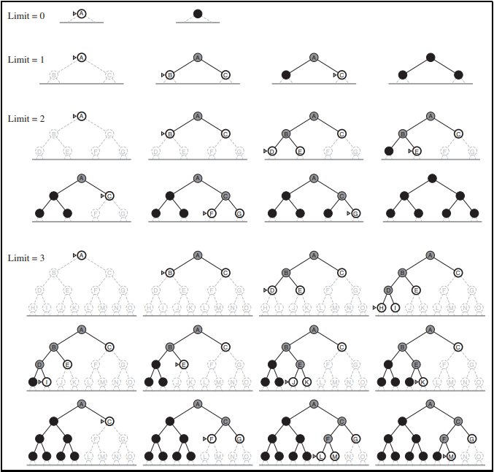
Iterative Deepening Depth-First Search
In this strategy,

Slide 26
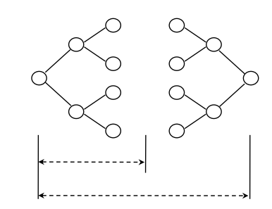
Bidirectional Search
The idea behind bidirectional search is to run two simultaneous searches—one forward from the initial state and the other backward from the goal—hoping that the two searches meet in the middle.
It then, expands nodes from the start and goal state simultaneously.
It checks at each stage if the nodes of one have been generated by the other, i.e, they meet in the middle.
Completeness: yes
Optimality: yes (If done with correct strategy- e.g. breadth first)
Time complexity: O(b^{d/2})
Space complexity: O(b^{d/2})

Slide 27
Informed Search Methods
It uses domain-dependent (heuristic) information in order to search the space more efficiently.
Heuristic Search
Ways of using heuristic information:
Deciding which node to expand next, instead of doing the expansion in a strictly breadth-first or depth-first order;
In the course of expanding a node, deciding which successor or successors to generate, instead of blindly generating all possible successors at one time;
Deciding that certain nodes should be discarded, or pruned, from the search space.

Slide 28
Informed Search Methods
Informed Search uses domain specific information to improve the search pattern
Define a heuristic function
h(n), that estimates the "goodness" of a node n.
Specifically,
h(n) = estimated cost (or distance) of minimal cost path from n to a goal state.
The heuristic function is an estimate, based on domain-specific information that is computable from the current state description, of how close we are to a goal.

Slide 29
Best-First Search
Use an evaluation function f(n) that gives an indication of which node to expand next for each node.
usually gives an estimate to the goal.
the node with the lowest value is expanded first.
A key component of f(n) is a heuristic function, h(n),which is a additional knowledge of the problem.
Special cases: based on the evaluation function.
Greedy best-first search
A*search

Slide 30
Remember
Remember
g(n) = path cost from the start node to node n
h(n) = estimated cost to goal from n
f(n) = estimated total cost of path through n to goal

Slide 31
Greedy Best-First Search
Greedy best first search expands the node that seems to be closest to the goal node.
Evaluation function based on Heuristic function is used to estimate which node is closest to the goal node.
The node with the lowest evaluation is selected for expansion because that is the best node, since it supposedly has the closest path to the goal (if the heuristic is good).
Evaluation function:
f(n) = h(n) (heuristic) = estimate of cost from n to goal
e.g., h_{SLD}(n) = straight-line distance from n to goal

Slide 32
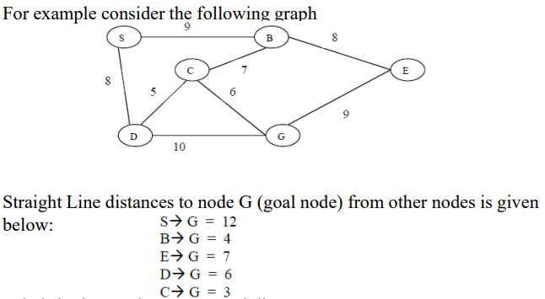
Greedy Best-First Search
Find path from S to G

Slide 33
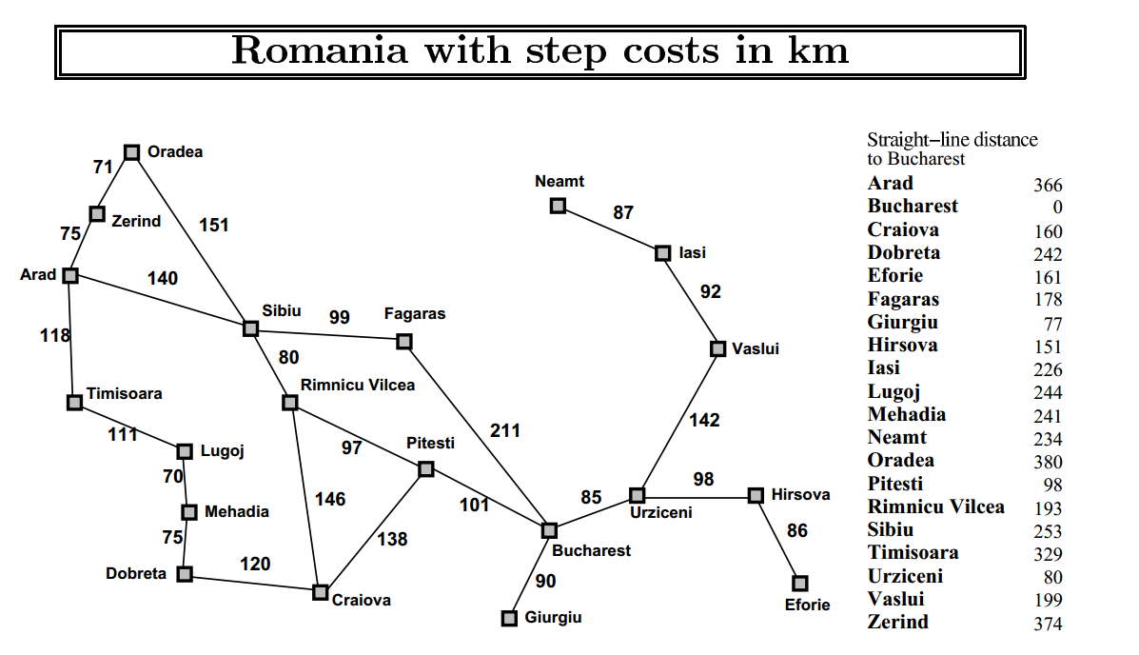
Greedy Best-First Search
Example: Given following graph of cities, starting at Arad city, problem is to reach to the Bucharest

Slide 34
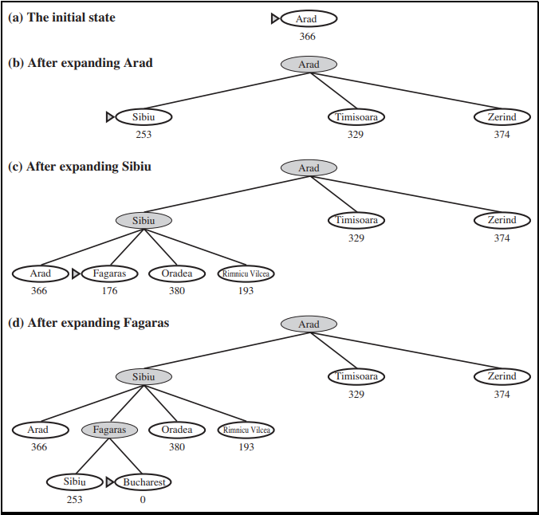
Greedy Best-First Search
Solution using Greedy Best-First Search

Slide 35
Greedy Best-First Search
Admissible Heuristic:
In other words, a heuristic is admissible if it never overestimates the cost of reaching the goal.
A heuristic function is said to be admissible if it is no more than the lowest-cost path to the goal.
An admissible heuristic is also known as an optimistic heuristic.
For all n, h(n) ≤ C(n)

Slide 36
A* Search
A* is a best first, informed graph search algorithm.
A* is different from other best first search algorithms in that it uses a heuristic function h(x) as well as the path cost to the node g(x), in computing the cost f(x).
The search begins at root node. The search continues by visiting the next node which has the least evaluation.
Evaluation Function:
f(n) = g(n) + h(n)
h(n) – estimated cost from current node to goal
g(n) – actual cost up to now
It finds a minimal cost-path joining the start node and a goal node for node n.

Slide 37
A* Search
Use A* search to find path from S to G

Slide 38
A* Search
Process:
As A* traverses the graph, it follows a path of the lowest known path, keeping a sorted priority queue of alternate path segments along the way.
If, at any point, a segment of the path being traversed has a higher cost than another encountered path segment, it abandons the higher-cost path segment and traverses the lower-cost path segment instead.
This process continues until the goal is reached.

Slide 39
A* Search
About admissible:
A* is admissible and considers fewer nodes than any other admissible search algorithm with the same heuristic.
This is because A* uses an "optimistic" estimate of the cost of a path through every node that it considers.
Thus, if estimated distance h(n) never exceed the true distance h*(n) between the current node to goal node, the A* algorithm will always find a shortest path
This is known as the admissibility of A* algorithm and h(n) is a admissible heuristic.

Slide 40
Hill Climbing Search
Hill climbing can be used to solve problems that have many solutions, some of which are better than others.
It starts with a random (potentially poor) solution, and iteratively makes small changes to the solution, each time improving it a little.
When the algorithm cannot see any improvement anymore, it terminates.
Ideally, at that point the current solution is close to optimal, but it is not guaranteed that hill climbing will ever come close to the optimal solution.
Note: The algorithm does not maintain a search tree and does not look ahead beyond the immediate neighbors of the current state.
So, no reversing and backtracking.

Slide 41
Hill Climbing Search
It is like DFS where most promising node is selected for expansion.
It is an iterative algorithm that starts with an arbitrary solution to a problem and attempts to find a better solution by changing a single element of the solution incrementally.
If the change produces a better solution, an incremental change is taken as a new solution.
This process is repeated until there are no further improvements.
Simple Hill climbing: It examines the neighboring nodes one by one and selects the first neighboring node which optimizes the current cost as next node.
Steepest-Ascent Hill climbing: It first examines all the neighboring nodes and then selects the node closest to the solution state as next node.

Slide 42
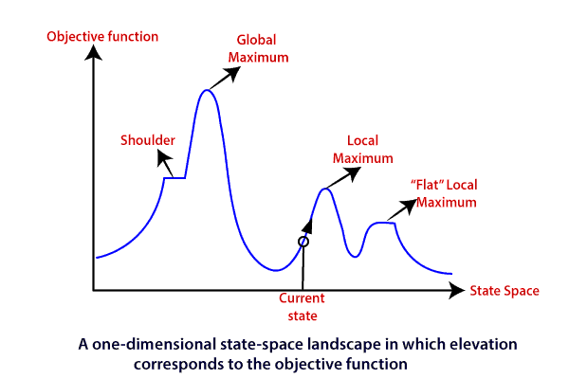
Hill Climbing Search
Advantages:
Hill climbing can produce substantial savings over blind searches when an informative, reliable function is available to guide the search to a global goal.
It suffers from some serious drawbacks when this is not the case.
Disadvantages:
This algorithm is neither complete, nor optimal.
Potential problem types local maximum, plateau and ridge.

Slide 43
Simulated Annealing
A hill-climbing algorithm that never makes “downhill” moves toward states with lower value (or higher cost) is guaranteed to be incomplete, because it can get stuck on a local maximum.
In simulated annealing, at each iteration a new point is randomly generated.
In metallurgy, simulated annealing is the process used to temper or harden metals and glass by heating them to a high temperature and then gradually cooling them, thus allowing the material to reach a low energy crystalline state.

Slide 44
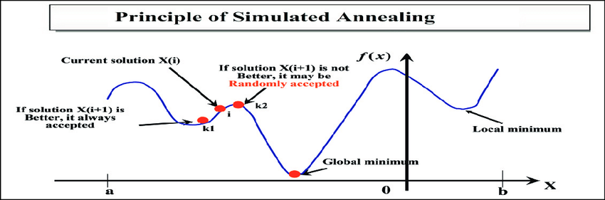
Simulated Annealing
Simulated annealing differs from hill climbing in that a move is selected at random and then decides whether to accept it.
If the move is better than its current position then simulated annealing will always take it.
If the move is worse (i.e. lesser quality) then it will be accepted based on some probability.
The probability of accepting a worse state is given by the equation
P = e^(-c /t)
Where c = the change in the evaluation function i.e. c=f(B)-f(A)
t = the current value

Slide 45

Game Search
Games are a form of multi agent environment.
Multi agent environments are either cooperative or competitive
Competitive multi agent environment give rise to adversarial search known as games
Examples: chess, checkers, Othello
Solution is strategy (strategy specifies move for every possible opponent reply)

Slide 46
Game Search
Solution is strategy (strategy specifies move for every possible opponent reply)
Difference between the search space of a game and the search space of a problem:
In the first case it represents the moves of two (or more) players, whereas in the latter case it represents the "moves" of a single problem-solving agent.
The initial state, ACTIONS function, and RESULT function define the game tree for the game—a tree where the nodes are game states and the edges are moves.

Slide 47
Game Search
A game can be formally defined as a kind of search problem as below:
S0: The initial state, which specifies how the game is set up at the start.
PLAYER(s): Defines which player has the move in a state.
ACTIONS(s): Returns the set of legal moves in a state.
RESULT(s, a): The transition model, which defines the result of a move.
TERMINAL-TEST(s): A terminal test, which is true when the game is over and false otherwise. States where the game has ended are called terminal states.
UTILITY(s, p): A utility function (also called an objective function or payoff function), defines the final numeric value for a game that ends in terminal state s for a player p. In chess, the outcome is a win, loss, or draw, with values +1, 0, or -1

Slide 48
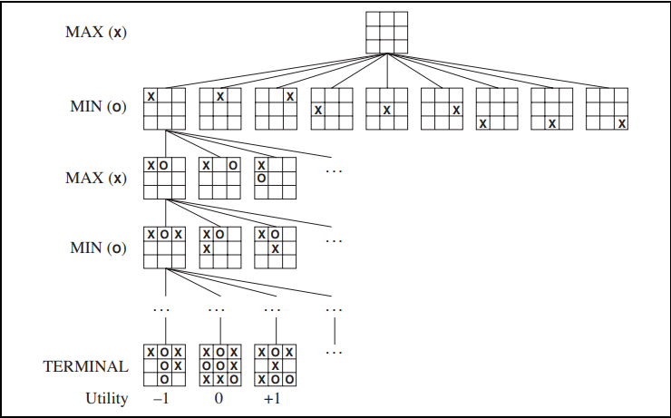
Game Search
A game: Tic-tac-toe
There are two players denoted by X and O.
They are alternatively writing their letter in one of the 9 cells of a 3 by 3 board.
The winner is the one who succeeds in writing three letters in line.
Terminal states are those representing a win for X, loss for X, or a draw.

Slide 49
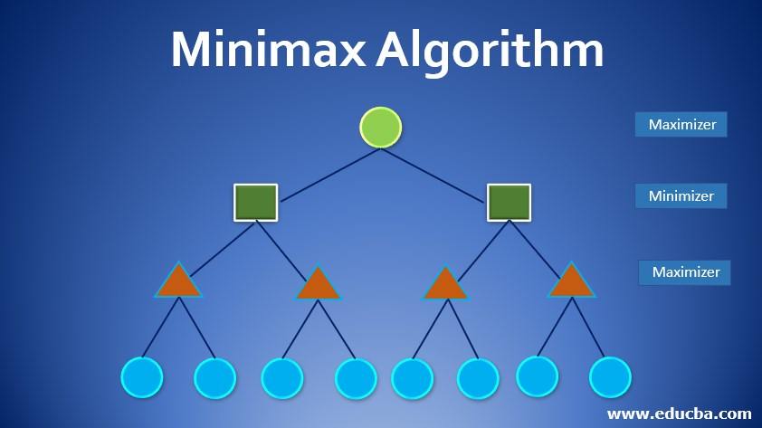
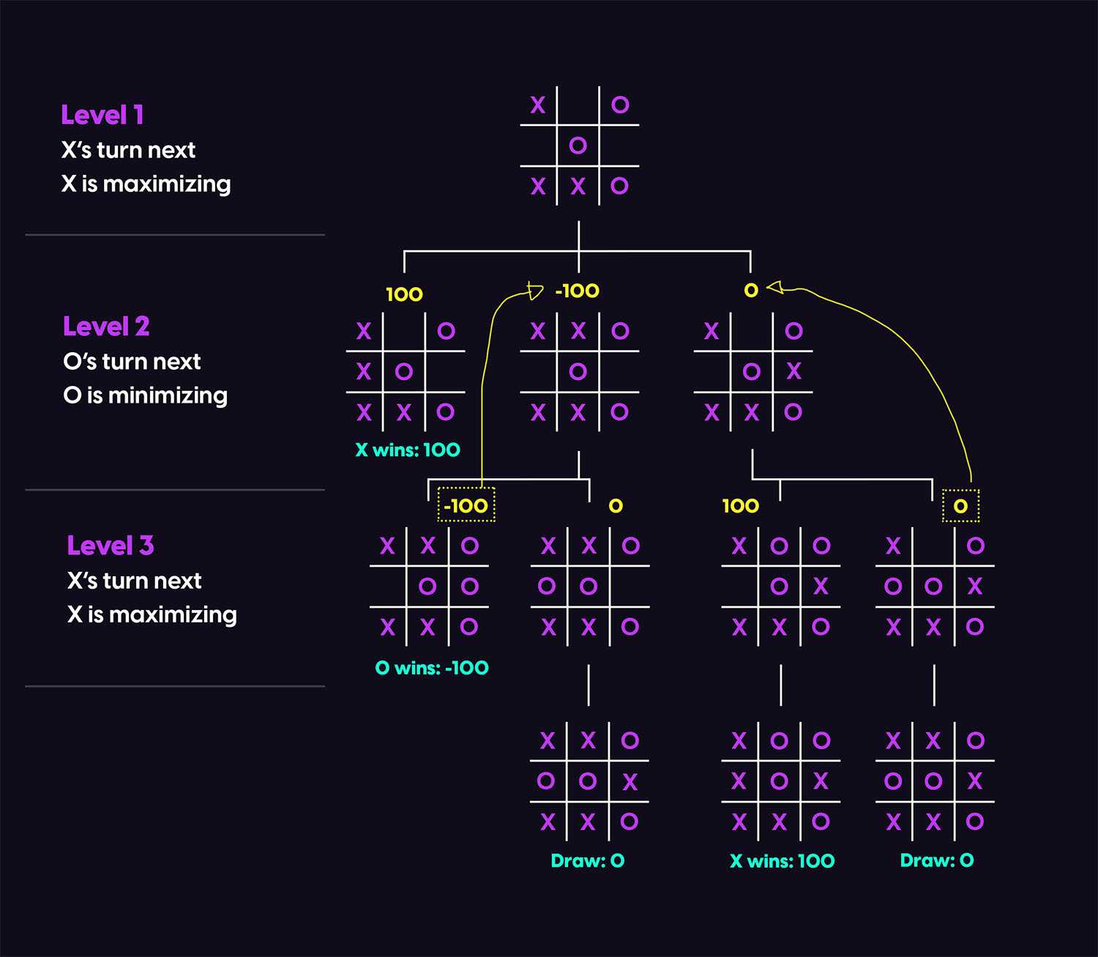
Game Search
The Minimax Algorithm
The value of a node where it is the turn of player X to move is the maximum of the values of its successors (because X tries to maximize its outcome)
The value of a node where it is the turn of player O to move is the minimum of the values of its successors (because O tries to minimize the outcome of X).

Slide 50
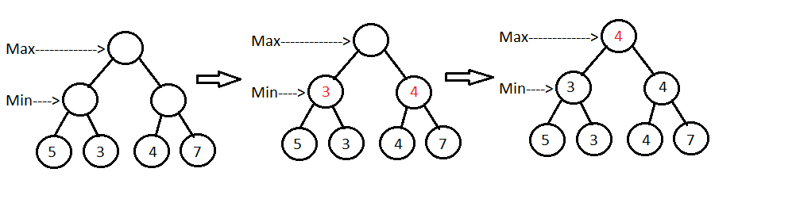
Game Search
The Minimax Algorithm

Slide 51
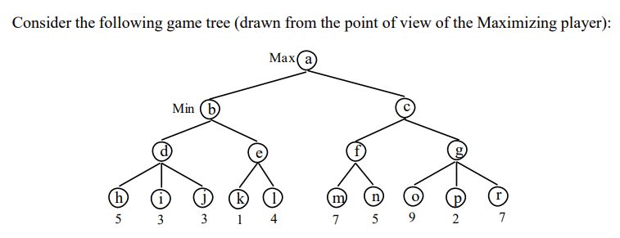
Game Search
The Minimax Algorithm

Slide 52
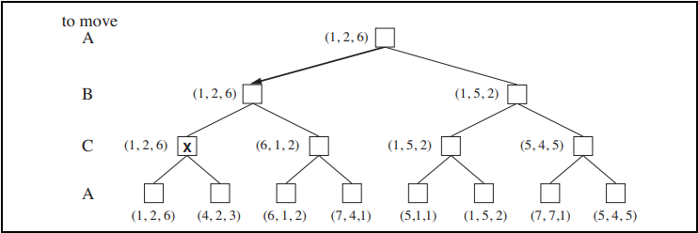
Game Search
Multi player games

Slide 53
Limitations of Mini-max search
The problem with minimax search is that the number of game states it has to examine is exponential in the depth of the tree.
Mini-max search traverse the entire search tree but it is not always feasible to traverse entire tree.
Time limitations

Slide 54
Alpha-beta pruning
We can improve on the performance of the mini-max algorithm through alpha-beta pruning.
If a move is determined worse than another move already examined, then there is no need for further examination of the node.
When applied to a standard minimax tree, it returns the same move as minimax would, but prunes away branches that cannot possibly influence the final decision.
Alpha-beta pruning is a technique for evaluating nodes of a game tree that eliminates unnecessary evaluations. It uses two parameters, alpha and beta.
Alpha: is the value of the best (i.e. highest value) choice we have found so far at any choice point along the path for MAX.
Beta: is the value of the best (i.e. lowest-value) choice we have found so far at any choice point along the path for MIN.

Slide 55
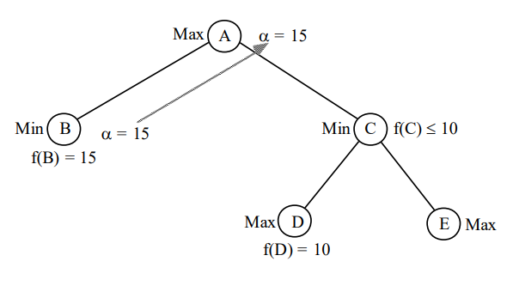
An alpha cutoff
To apply this technique, one uses a parameter called alpha that represents a upper bound for the achievement of the Max player at a given node.
Let us consider that the current board situation corresponds to the node A in the following figure.

Slide 56
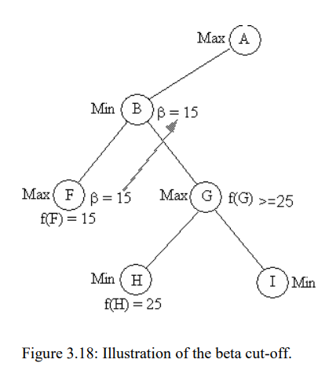
An beta cutoff
To apply this technique, one uses a parameter called beta that represents an lower bound for the achievement of the Min player at a given node.
Let us consider that the current board situation corresponds to the node B in the following figure.

Slide 57
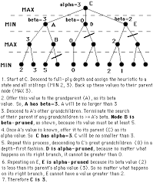
An alpha-beta cutoff
Example

Slide 58
Constraint Satisfaction Problem
A constraint satisfaction problem consists of three components, X, D, and C:
X is a set of variables, {X₁,...,X_{n}}.
D is a set of domains, {D₁,...,D_{n}}, one for each variable.
C is a set of constraints that specify allowable combinations of values. i.e. relations, that are assumed to hold between the values of the variables.
Each domain Di consists of a set of allowable values, {v₁,...,v_{k}} for variable X_{i}.

Slide 59
Constraint Satisfaction Problem
To solve a CSP, we need to define a state space and the notion of a solution.
Each state in a CSP is defined by an assignment of values to some or all of the variables, {X_{i} = v_{i}, X_{j} = v_{j} ,...}.
Consistent
An assignment that does not violate any constraints is called a consistent or legal assignment.
Complete
A complete assignment is one in which every variable is assigned.
A solution to a CSP is a consistent, complete assignment.

Slide 60
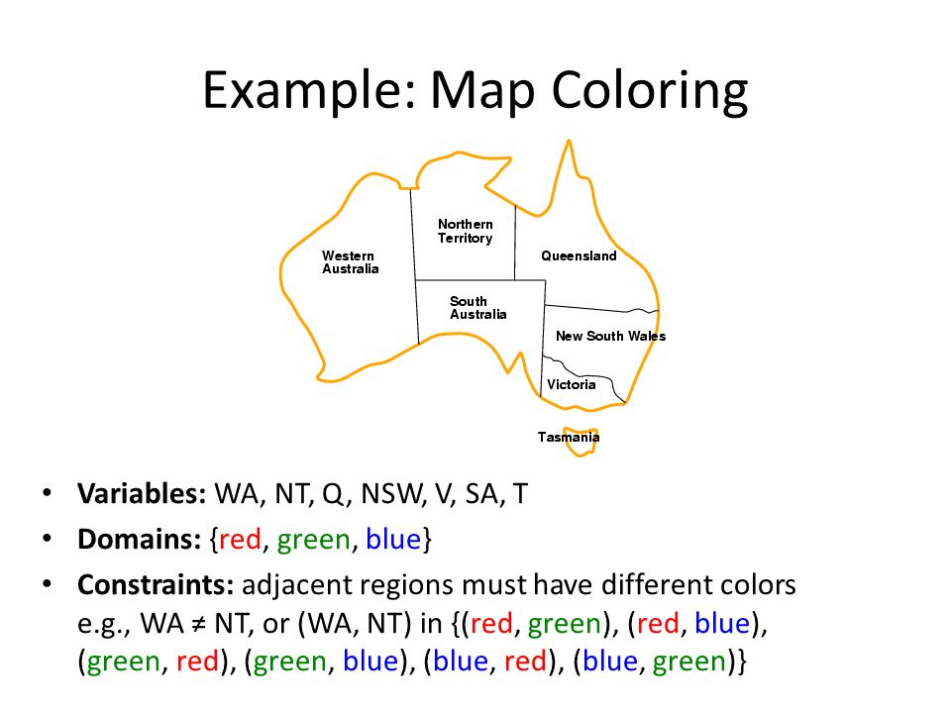
Constraint Satisfaction Problem
Example (Map-Coloring problem):
Given, a map of Australia showing each of states and territories.
The task is color each region either red, green, or blue in such a way that no neighboring regions have the same color.
• This problem can be formulated as CSP as follows:
Variables: WA, NT, Q, NSW, V, SA, T
Domains: Di = { red, green, blue}
Constraints: adjacent regions must have different colors
• e.g., WA ≠ NT

Slide 61
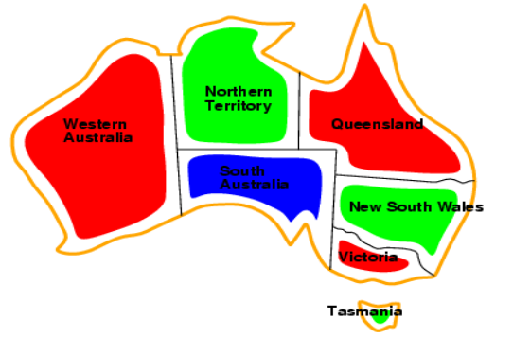
Constraint Satisfaction Problem
Solutions are complete and consistent assignments

Slide 62
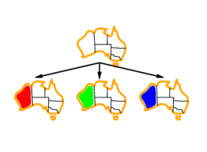
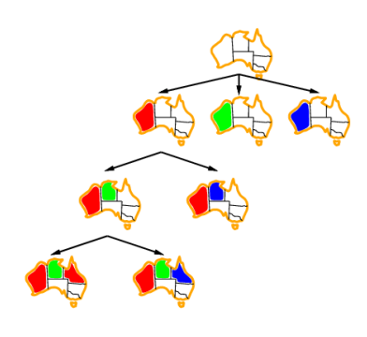
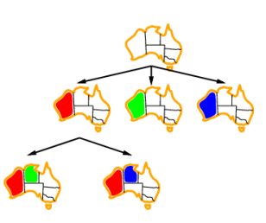
Constraint Satisfaction Problem
Step – 1
Step - 3
Step - 2

Slide 63
Thank you !

